Slide 1
Computing at Hull
David Grey, Rob Miles Department of Computer Science

Slide 2
Introduction
We are going to
Introduce ourselves
Tell you a bit about computer science at Hull
Give you a practical demonstration of some of the cool stuff we like to play around with (3D printing)
Tell you about extra-curricular activities we encourage our students to participate in
Eat all the biscuits and leave!

Slide 3
What We Do
We are passionate about software engineering
The process of building software systems
We believe in producing graduates who
Can actually do stuff and build software systems using the latest technologies
Have a range of skills that make them more employable
Can make an immediate and useful contribution to their employers
And we like it to be fun!
www.wherewouldyouthink.com

Slide 4
What We Teach
Computer Science
Computer Software Development
Information Systems
CS with Games Development
Computer Systems Engineering
i.e. software engineering in different problem domains (business software, entertainment software, etc)

Slide 5
3D Printing
Rob Miles
Department of Computer Science
University of Hull

Slide 6
Agenda
3D Printing Overview
3D Printing Workflow
Design something and Print it
The future of 3D Printing
Notes:
PROVIDE AN AGENDA FOR YOUR SESSION. SET EXPECTATIONS.

Slide 7
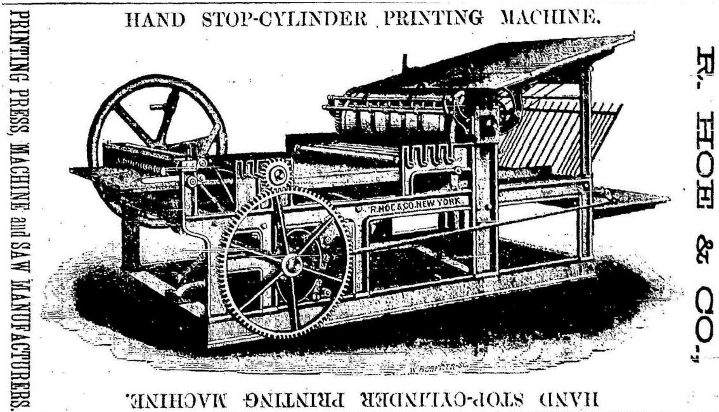
Printing
Not that many years ago having your own colour printer was the stuff of dreams
Nowadays you can buy them for next to nothing
Although the ink is always very expensive

Slide 8
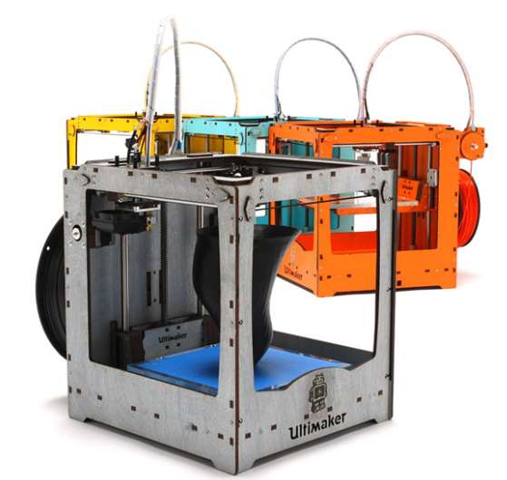
3D Printing
Printing in 3D might seem as far fetched as everyone owning their own colour printer, or TV camera, did a few years ago
The technology is now becoming almost mainstream
We can print cheaply enough, and in sufficiently strong materials to make the technology viable

Slide 9
Uses for 3D Printing
Rapid prototyping of designs
Prove that a physical design works as expected
Short production runs of components
It may be uneconomical to mass produce the item
Print things that can’t be made any other way
Can print objects “inside” each other

Slide 10
3D Printing Technologies
There are lots of ways to print in 3:
Selective Heat Sintering
Heat up powdered plastic so it melts and fuses together and forms hard objects
Digital Light Processing
Shine a UV light onto liquid plastic which makes it harden
Fused Deposition Modelling
Lay down layers of material which is extruded onto a flat bed
Each has its advantages and disadvantages
I don’t think any of them are ready for prime time yet

Slide 11
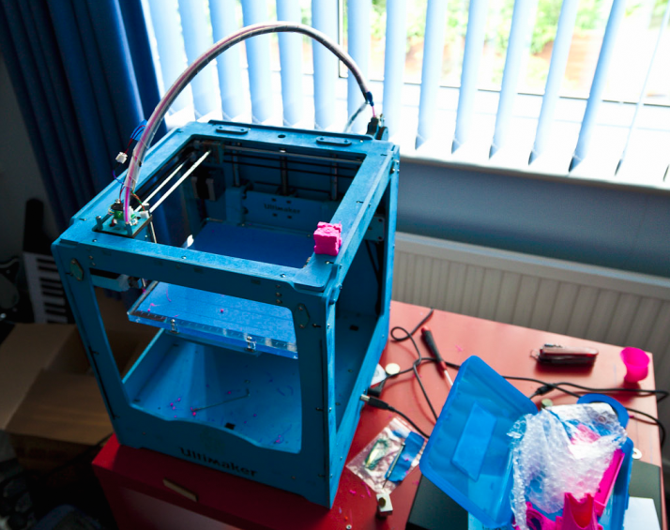
Introducing Una
Una is an FDM 3D printer
She prints by “knitting” together a continuous hot plastic fibre to make solid objects
She is a bit temperamental, but when she is in a good mood she can print some amazing stuff

Slide 12
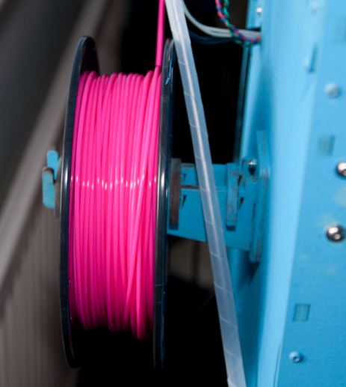
Raw Materials
Una can print on ABS or PLA types of plastic
PLA is biodegradable and melts at a lower temperature
It is supplied as a 3mm wide fibre strand which is fed into the machine from a roll

Slide 13
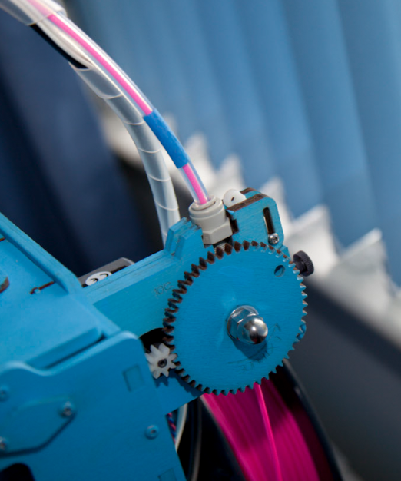
Feeding Plastic
The drive motor pushes the plastic fibre into the clear tube towards the print head
This is called the “Bowden Tube”
At this point the plastic is still solid
Note that one of the gears is made of wood….

Slide 14
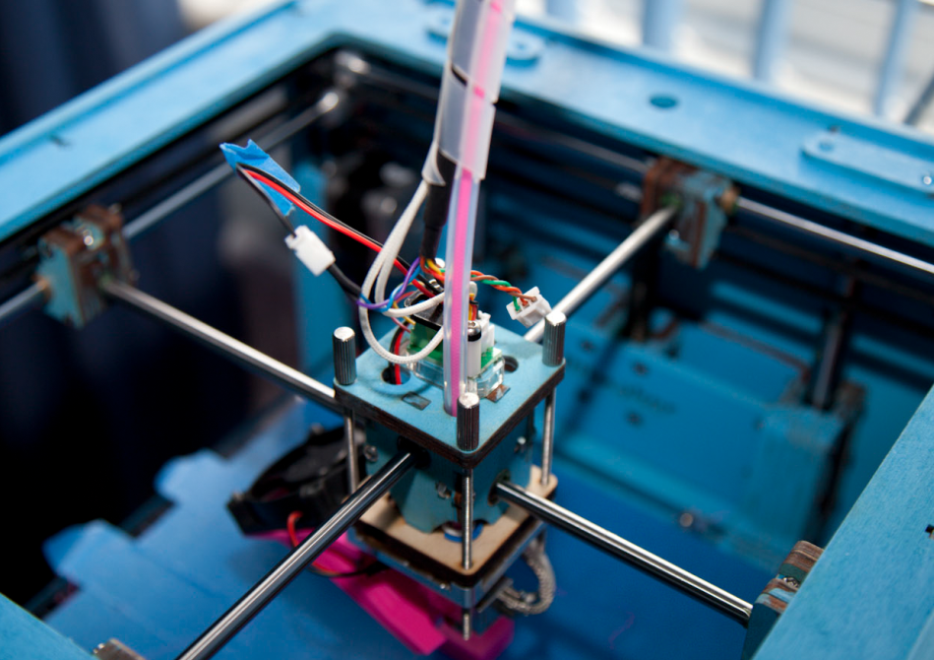
The Print Head
The print head is driven left and right by stepper motors
These allow very precise positioning
The plastic fibre is fed through the Bowden Tube into the print head at the top

Slide 15
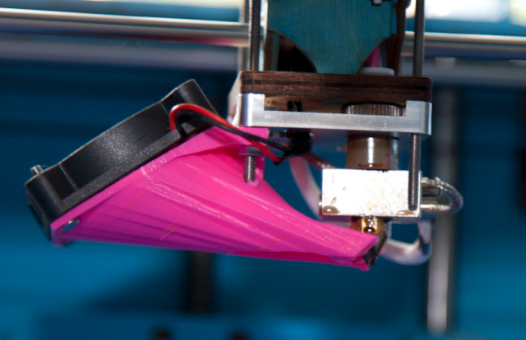
The Print Head
The shiny metal block in the middle contains a heater that melts the plastic
It then comes out of the print nozzle at the bottom and lands on the thing Una is building
Una builds each layer in turn

Slide 16
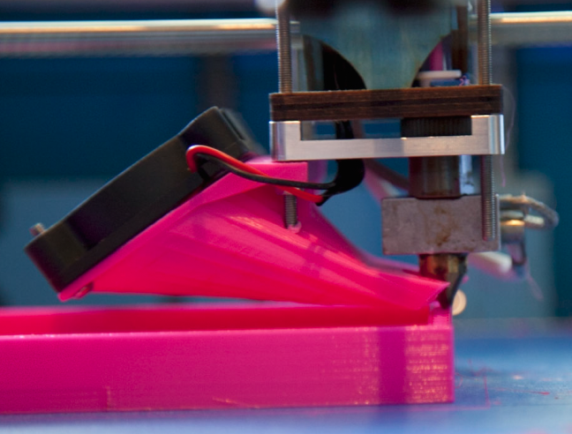
Printing in action
Here Una is building the side of a box
The hot plastic is coming out of the brass nozzle
The fan on the left is cooling it down so that it sticks to the previous layer

Slide 17
FDM Printing
The great thing about FDM printing is that it works
There are a few less great things though
Models are built up of layers, which means that things like overhangs are hard for printer to produce
You can print at an angle of up to around 45 degrees before things start to go badly
The material itself is prone to shrink as it cools, leading to warping of flat surfaces
You can only print in one colour at a time

Slide 18
3D Printing Workflow
Create the design using a 3D package
FreeCad, Autodesk 123D, Sketchflow all work well
Export to an STL file
This contains a mesh that describes the object to be printed
Slice the mesh to produce a “GCode” file that describes the printer path
I use a program called Cura to do this
Send the design to the printer

Slide 19
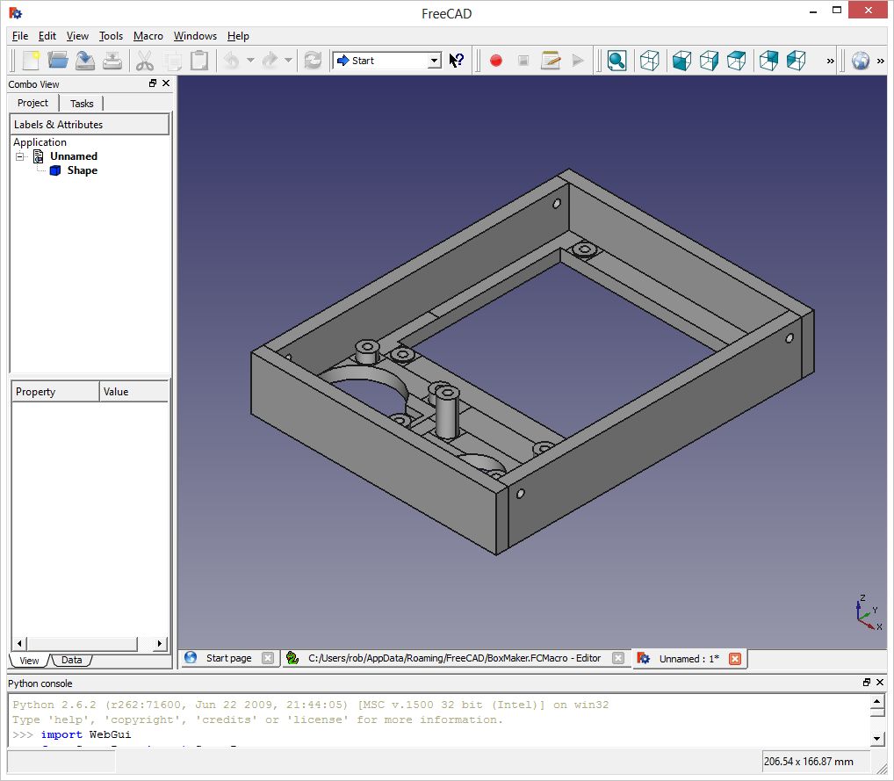
FreeCAD
FreeCAD lets you design things in 3D
This can be a bit painful
Visualising and manipulating things in 3D is hard

Slide 20
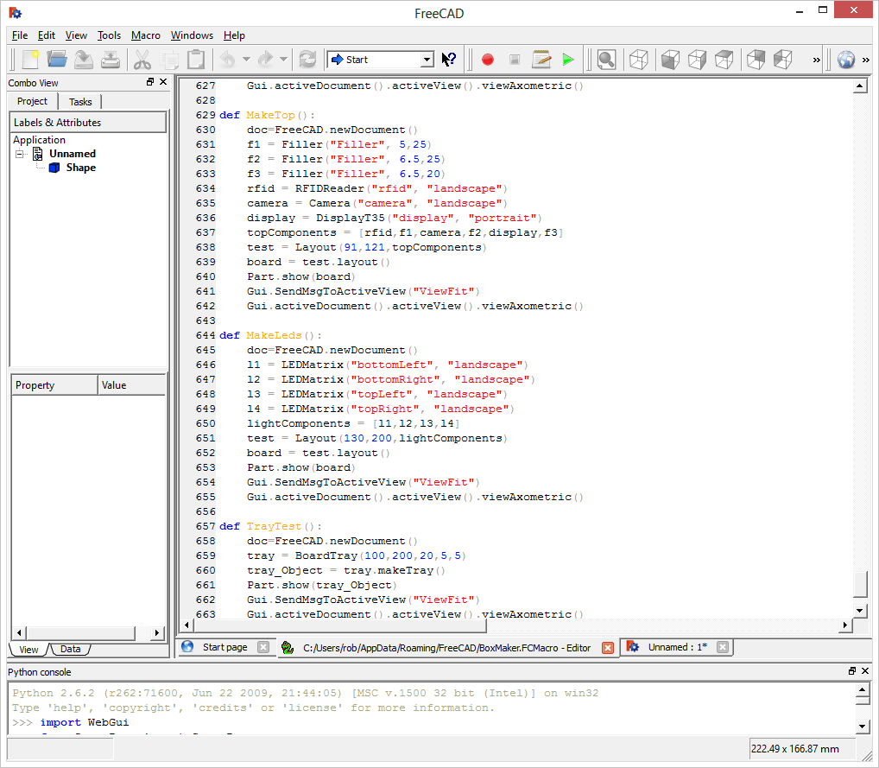
FreeCAD and Python
One of the great things about FreeCAD is that it lets you generate objects using Python programs
These run inside the tool and let you create objects programmatically

Slide 21
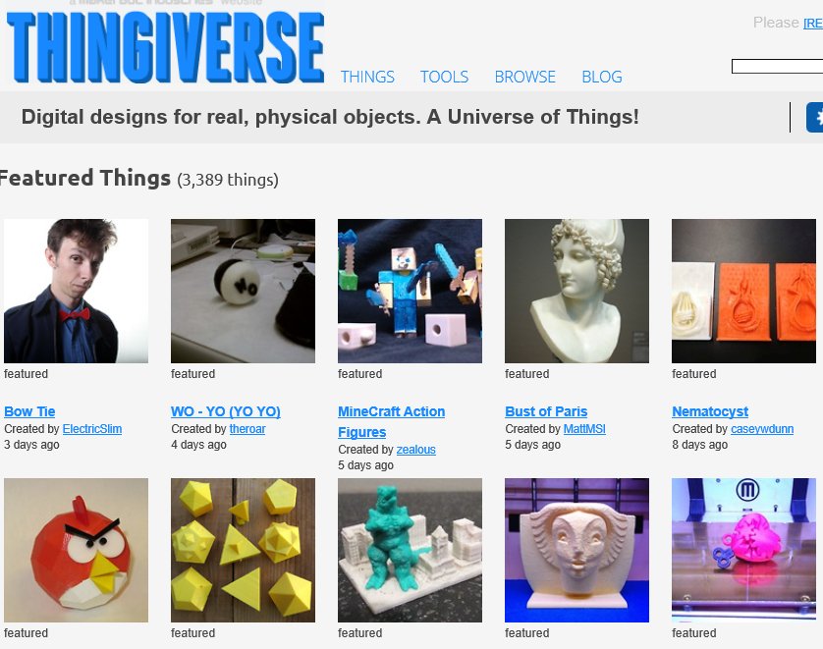
What can you print
You can print anything
within reason..
There is quite a community of people who make and share object designs
I use thingiverse.com as a good starting point

Slide 22
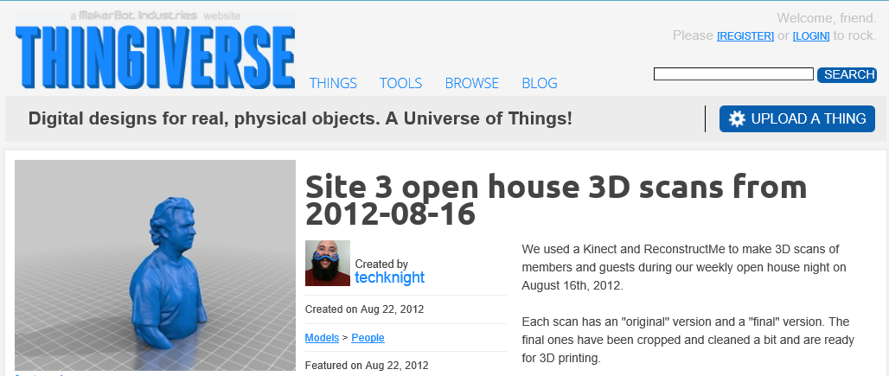
3D Scanning
There is an iPhone app called 123D Catch from Autodesk which will take 40 pictures and make a 3D model from them
You can use the new Microsoft Kinect SDK to scan in 3D

Slide 23
3D Printing and Fun
You can generate the designs (and even the GCode files) programmatically
The printer firmware can also be reprogrammed
Many printer designs and control software are open source, so you can fiddle with them
You can also use a 3D printer to print parts to make another 3D Printer
You can also print extra parts for your printer

Slide 24
3D Printing and the Future
Selling 3D printing technology as something which is here now is being wildly optimistic
Although they are great fun to tinker with and for prototyping at a very low cost
It is pretty much certain that our future will contain 3D printers of some kind
Although I’m not convinced that the current generation of technology will be how they end up working
They need to get a lot cheaper
They need to be able to print in colour
They raise a whole new set of copyright issues

Slide 25
Useful Stuff
3D Printers and Cura
http://www.ultimaker.com/
Free 3D Design and Scanning Tools
http://www.sketchup.com http://sourceforge.net/projects/free-cad/
http://www.123dapp.com/
Things
http://www.thingiverse.com/
My Blog
http://www.robmiles.com

Slide 26
Fun Stuff at Hull (Extracurricular Activities!)

Slide 27
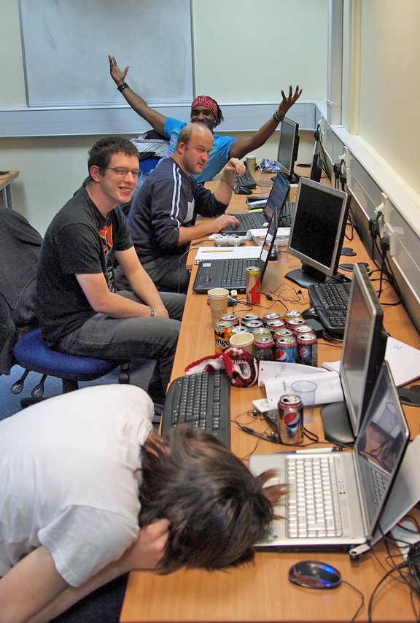
Three Thing Game
Every semester we have a game development event in the department
Students are given 24 hours to complete a game
They love doing it
Last time we had nearly 100 students take part
www.threethinggame.com

Slide 28
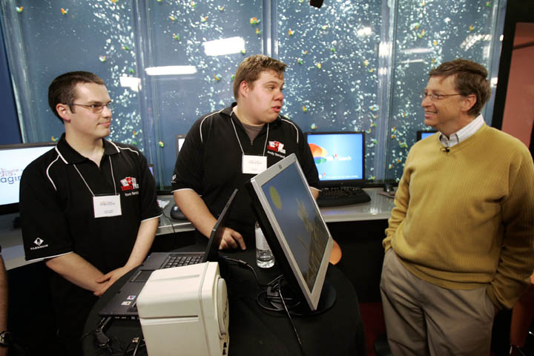
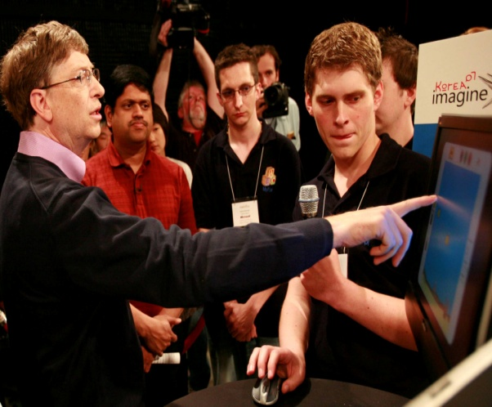
Microsoft Imagine Cup
We have an unbeatable record of achievement in the Imagine Cup Software Development Challenge
In fact we have won the UK Final three times
One year we got the top three places
Two of our teams have met Bill Gates and taken part in the world finals
In 2006 we went to India
In 2007 we went to Korea
In 2008 a Hull graduate mentored the UK winners
In 2009 we got 4 teams into the UK Finals
In 2010 we got 2 teams into the UK and came 3rd
We are preparing entries for next year…

Slide 29
Why do we do the fun stuff? (and why you should care)
Because
It’s fun!
It gives students valuable skills which look good on a CV
Gives our students greater success in the job market

